Slide 1


Analyzing and solving handwritten mathematical equations using AI
Github link: https://github.com/TanmayThaker/Evaluating_Mathematical_Equations_Using_AI

Slide 2
Team 42 members
Neel Solanki
Tanmay Thaker
18BIT079
18BIT111
Parth Salat
18BIT083
Shiv Virpariya
18BIT101
Shivrajsinh Rana
18BIT102
Rushabh Kumbhani
18BIT095

Slide 3
Introduction
2
4
Before the correct
implementation of this technology we were dependent on
writing texts with our own hands that result in errors.
Since for long time we have encountered a severe loss of data because of the traditional method of storing data.
I
N
T
R
O
1
3
5
The Handwritten text system is commonly used system in various applications, and it is a technology that is a mandatory need in this world as of now.
It’s difficult to store, access physical data and process the data in efficient manner. Manually it is needed to update, and labor is required in order to maintain proper organization of the data.
Adoption of the Handwritten Text Recognition software is a practical idea and, it is easier to store and access data that was traditionally stored. Furthermore, it provides more security to the data.

Slide 4
Problem Statement
Calculating/evaluating the expression
Deploying the app/website
Finally, we’ll deploy the model on an app/website
The heart of the project lies in solving the given mathematical expression
04
03
Detecting operators
Operators can be detected just like digits
Detecting digits
Handwritten digits recognizer can be employed to identify digits
02
01

Slide 5
Problem definition
1
2
3
4
Handwriting Detection is a technique or ability of a Computer to receive and interpret intelligible handwritten input from source such as paper documents, touch screen, photo graphs etc
Handwritten Text recognition is one of area pattern recognition. The purpose of pattern recognition is to categorizing or classification data or object of one of the classes or categories.
The automatic recognition of handwritten text can be extremely useful in many applications where it is necessary to process large volumes of handwritten data, such as interpretation of amounts on bank checks, document analysis, and verification of signatures
Therefore, computer is needed to be able to read document or
data for ease of document processing.

Slide 6
Our Dataset:
subset of CROHME dataset

Slide 7
Dataset’s description
1
4
Dataset consists of jpg files (28 x 28).
Original source, that was parsed, extracted and modified is CROHME dataset.
2
5
For simplicity, we are using 0–9 digits, +, — and, times images in our equation solver.
The CROHME dataset provides more than 10,000 expressions handwritten by hundreds of writers from different countries, merging the data sets from 3 CROHME competitions.
3
6
On observing our dataset, we can see that it is biased for some of the digits/symbols, as it contains 12000 images for some symbol and 3000 images for others. To remove this bias, we reduced the number of images in each folder to approx. 4000.
Different devices have been used (different digital pen technologies, white-board input device, tablet with sensible screen) so different scales and resolutions are used.

Slide 8
Literature survey
New and more sophisticated methods
Related to the extraction and usage of better skeletons, and more reliable topological and morphological features; multiple modules, multiple-layer and neural networks to recognize handwritten characters.
Multi-stage classification methods
In multistage systems, simpler and more efficient methods are used to classify well-formed characters while more complex and costly methods are required for characters of poorer quality.
Multi-expert combination methods
In multi-expert systems, the outcomes of many methods are combined using majority voting or some more complex rule. Here the rationale is to design and combine algorithms to reinforce each other, thus relying on more extensive, diversified and complementary sources of information concerning the problem to be solved.

Slide 9
Literature survey (contd.)
New and more sophisticated methods
Guyon, I., Henderson, D., Albrecht, P., Lecun, Y., & Denker, J. S. (1992). Writer independent and writer adaptive neural network for on-line character recognition. In S. Impedovo, & J. C. Simon (Eds.), From pixels to features III: Frontiers in handwriting recognition (pp. 493-506). Elsevier.
1
For recognition of on-line handwritten characters, Guyon use a feature vector which includes information about the direction of the tangent and the local curvature at every point along the strokes of online characters.
2
They also propose successful ways to improve the learning of atypical styles and to adapt the network to a particular writer.
3
Using a training set of 12000 samples from 350 writers and a test set of 2500 samples from a disjoint set of writers, they report a recognition rate of 93.7% with a 1% substitution rate.

Slide 10
Literature survey (contd.)
Multi-stage classification methods
Wang, P. S. P., Nagendraprasad, M. V., & Gupta, A. (1991, September). A hybrid approach to handwritten numeral recognition. In Proc. Second International Workshop on Frontiers in Handwriting Recognition, IWFHR II.
1
Wang uses 2 recognition algorithms sequentially to recognize hand printed numerals from the NIST (National Institute of Standards and Technology) database.
2
The first scheme is a neural network using a horizontal, a vertical and 2 diagonal histograms of size-normalized images as input vector; the samples rejected by the first method are recognized by a relaxed matching algorithm comparing their description (based on an 'improved Freeman chain code') to prototypes stored in a dictionary.
3
For 200 testing samples, the recognition rate was 88% with no mention of the substitution rate.

Slide 11
Literature survey (contd.)
Multi-expert combination methods
Kimura, F., & Shridhar, M. (1991). Handwritten numerical recognition based on multiple algorithms. Pattern recognition, 24(10), 969-983.
1
Kimura and Shridhar combine two algorithms to achieve very good classification of handwritten numerals. The first method divides the image into 16 rectangular zones and obtains, for each zone, the local histogram of chain codes with 4 values. Based on a learning set, a modified quadratic discriminant function is used as the first classifier.
2
The second approach is a tree classifier based on structural features extracted from the left and right profiles of the numerals: left and right peaks, location of minima and maxima etc.
3
Their best results were obtained with a parallel combination: recognition rates of 96.23%, 95.08% and 89.55% were achieved with corresponding substitution rates of 0.25%, 0.13% and 0.07%.

Slide 12
Proposed methodology
1
4
We use contour extraction to obtain features from the images in our dataset.
Since each image in our dataset contains only one symbol/digit, we only need the bounding rectangle of maximum size. For this purpose, we calculate the area of the bounding rectangle of each contour and select the rectangle with maximum area.
2
5
Invert the image and then convert it to a binary image because contour extraction gives the best result when the object is white and surrounding is black.
Now, resize the maximum area bounding rectangle to 28 by 28. Reshape it to 784 by 1. So there will be now 784-pixel values or features. Now, give the corresponding label to it (For e.g. for 0–9 images same label as their digit, for — assign label 10, for + assign label 11, for times assign label 12).
3
6
To find contours use ‘findContour’ function. For features, we obtain the bounding rectangle of contour using ‘boundingRect’ function (Bounding rectangle is the smallest horizontal rectangle enclosing the entire contour).
So now our dataset contains 784 features column and one label column. After extracting features, save the data to a CSV file.

Slide 13
Testing Our Model / Solving Equations using it
5
1
To avoid getting two or more contours for the same digit/symbol, we can check if the bounding rectangle of those two contours overlaps or not. If they overlap, then discard the smaller rectangle.
Firstly import saved model.
2
Now, input an image containing a handwritten equation. Convert the image to a binary image and then invert the image(if digits/symbols are in black).
6
Now, resize all the remaining bounding rectangle to 28 by 28.
3
7
Now obtain contours of the image. By default, it will obtain contours from left to right.
Using our CNN sequential model, predict the corresponding digit/symbol for each bounding rectangle and store it in a string.
4
8
Obtain bounding rectangle for each contour.
After that use ‘eval’ function on the string to solve the equation.

Slide 14
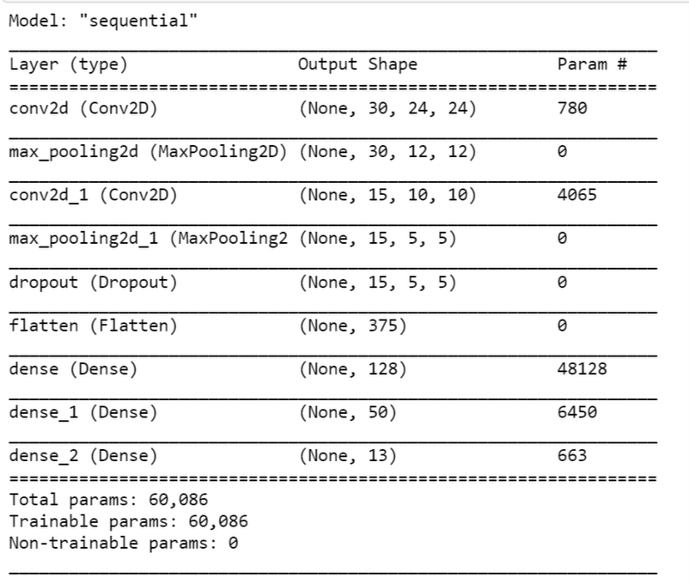
Model Summary

Slide 15
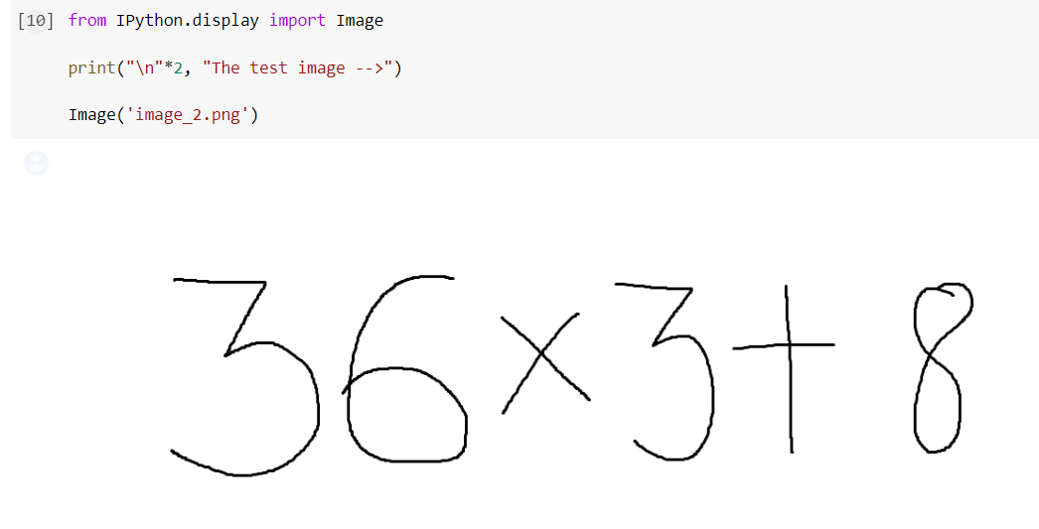
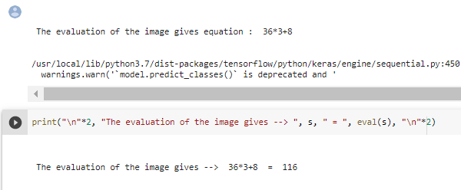
Results
After training we found our model’s accuracy to be around 98.4%.

Slide 16
Thank You
Team 42
Github link: https://github.com/TanmayThaker/Evaluating_Mathematical_Equations_Using_AI

